Slide 1
The Design Process and Flowcharts
A supplemental lesson for AP CSP

Slide 2
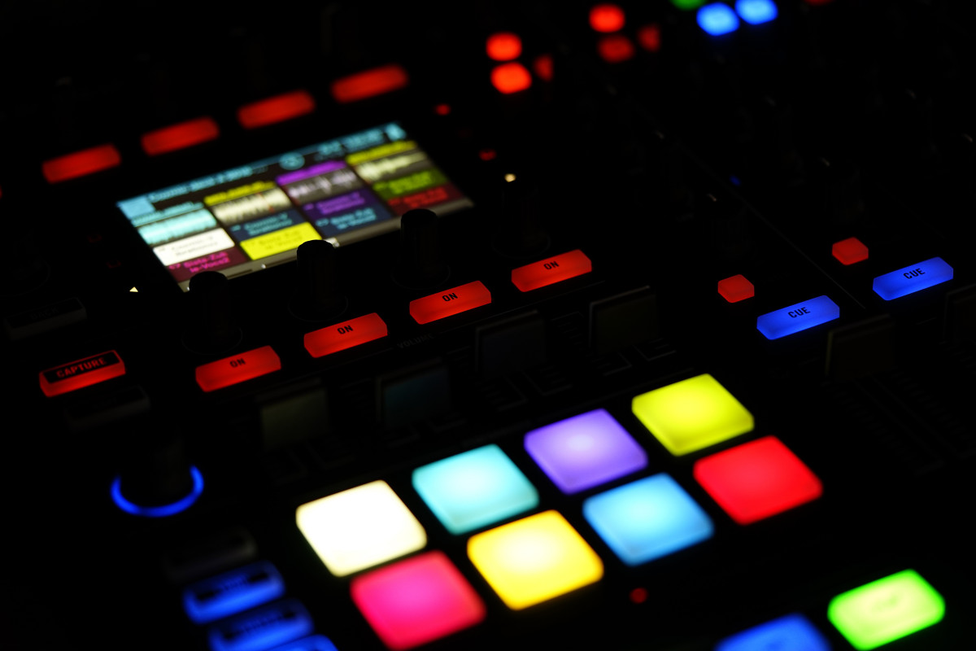
Review the remix project
When you created your Unit 1 Remix project, you were asked to follow 5 steps.
Let’s review them.

Slide 3
Review the steps for the remix project
Step #1
Step #2
Step #3
Review previous programs to remember what you already know how to do.
Come up with a new programming idea
Plan the solution to your idea: what it will look like (buttons pressed) and coding
Step #4
Step #5
Code the solution.
A few lines at a time
Documenting and fixing bugs
Get feedback on the project and improve it

Slide 4
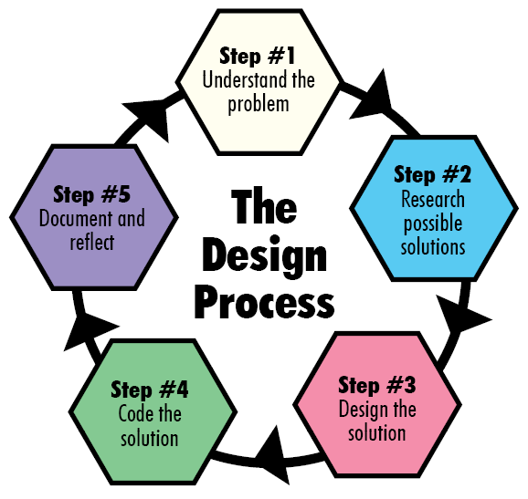
The Design Process
You were basically following the design process!
Many industries, including computer science, use a design process when working on a new project.
Definition: The design process is a tool that helps you break down large projects into smaller, easier-to handle stages

Slide 5
We just re-arrange the remix step 1 with step 2:
Step #1
Step #2
Step #3
Come up with a new programming idea that solves a problem – make sure you understand what it should do
Review what you already know how to do. What programming skills and concepts can you use?
Plan the solution to your idea: what it will look like (buttons pressed) and coding (variables, conditions, etc.)
Step #4
Step #5
Code the solution.
A few lines at a time
Documenting and fixing bugs as you go
Document your code. Get feedback on the project, and reflect on how it works so far. Then improve it.

Slide 6
The Design Process
As you can see, the design process is really a cycle:
Programmers frequently improve and modify their code.
After each complete cycle, a new problem may arise or idea that can add to the functionality of your program.
Then you start a new cycle all over again.
Each time you go through the cycle, you have completed one iteration.
Iteration is like repeating: you repeat the cycle as many times as needed.

Slide 7
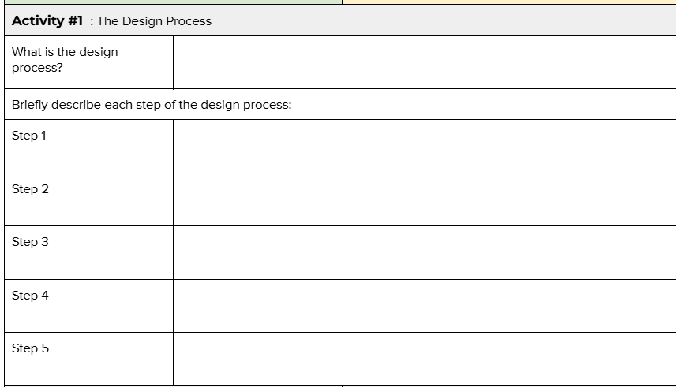
Activity Guide
Fill out Activity #1 in the activity guide.

Slide 8
Step #3 - Design a solution
In this lesson, we are going to focus on Step #3 - designing a solution
For the remix, you used several tables to help with designing
  Variables needed
  Buttons pressed
  Images displayed, pixels lit
  Functions

Slide 9
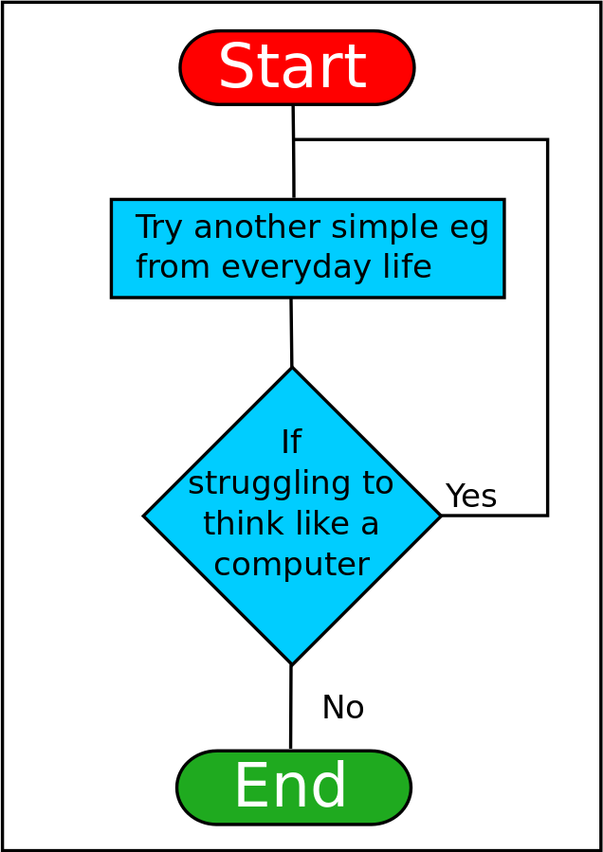
Flowcharts
Another useful tool programmers (and many other professionals!) use is a flowchart. Flowcharts can help you:
Organize your thoughts and ideas
Use shapes to visualize the solution
Track variables
Identify computations
Look for patterns
Source: https://en.wikiversity.org/wiki/File:ThinkLikeComputerFlowchart.svg

Slide 10
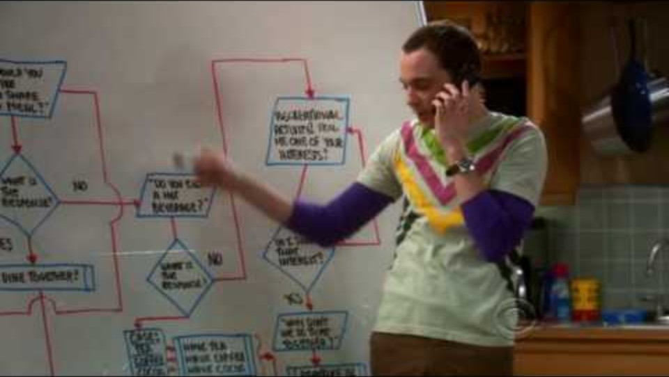
Flowcharts
Notes:
YouTube video link: https://www.youtube.com/watch?v=k0xgjUhEG3U

Slide 11
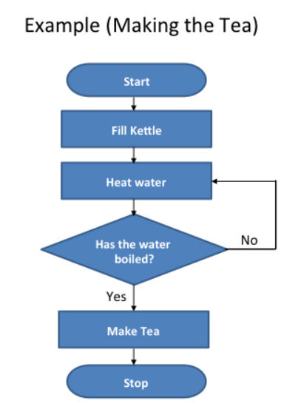
Flowcharts
A flowchart visualizes the algorithm, or how to solve the problem.
It is like a graphic organizer.
There are four common shapes used when creating a flowchart:
Source: https://www.teachwithict.com/flowcharts.html#google_vignette

Slide 12
Flowchart symbols
Use an oval to mark the beginning and end of the program.
start or stop
Use a parallelogram to show input or output. Input could be the button pressed. Output could be text on the console panel, LEDs lit, a sound played or movement.
input or output
flow lines
Use a rectangle to process an action. It could be used to assign a value to a variable, or increment a counter, or get a random number.
action or process
Use lines to connect the shapes. The arrows show the direction of the steps. Some lines should include labels, such as yes or no, to explain what is happening.
Use a diamond to make decisions. This shape will have two or more lines that come from it – one for each outcome. This step might ask a question or provide options. The result could be true or false, yes or no, or choices (red, blue, or green).
decision

Slide 13
Flowcharts
This example doesn’t include any input or output.
What can you think of to add to this flowchart?
What are some other examples of how the shapes might be used?
Source: https://www.teachwithict.com/flowcharts.html#google_vignette

Slide 14
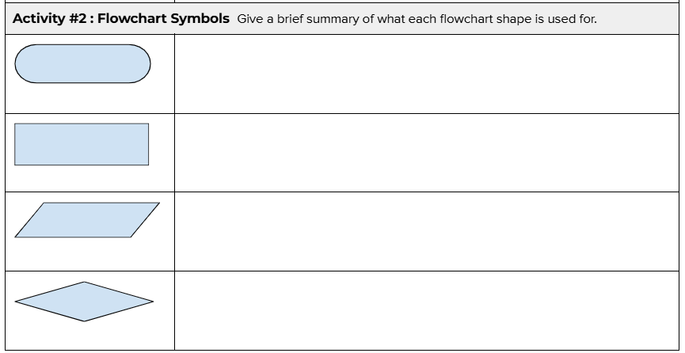
Activity Guide
Fill out Activity #2 in the activity guide.

Slide 15
Flowchart example #1
Display the answer
These shapes are mixed up. Can you fix the algorithm by putting the events in the correct order?
Activity Guide #3
Sum the numbers
Start
Stop
Player enters two numbers
Give instructions

Slide 16
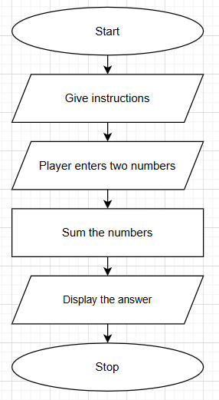
Did you get something like this?

Slide 17
Flowchart example #2
Computer gets a random number
Some of the steps are in the wrong shape, and they are out of order. Can you fix this flowchart?
Activity Guide #3
Give instructions
Display “you guessed it!”
Player enters a number
Did the player guess the number?
start
stop
Display “You didn’t guess it”

Slide 18
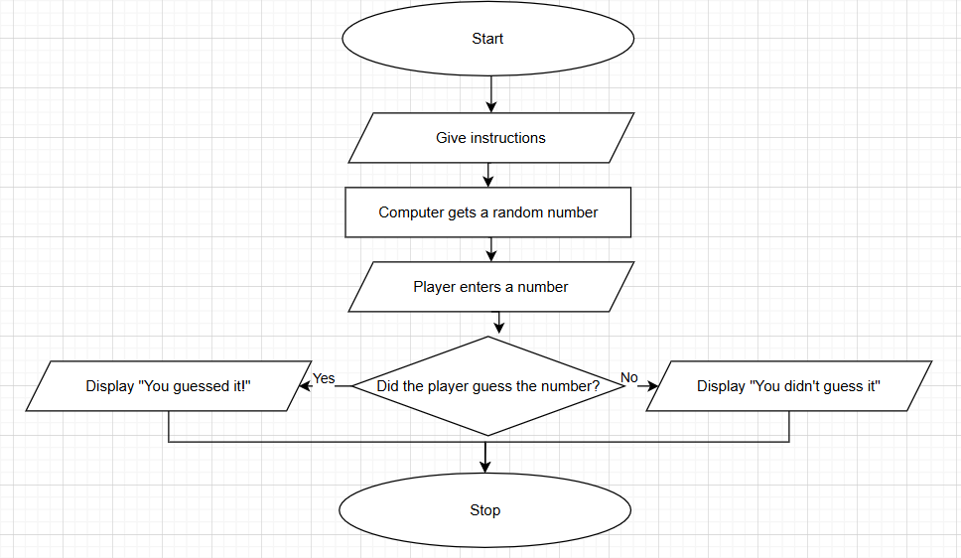
Did you get something like this?
It doesn’t have to be exactly the same – there can be more than one solution to a problem!

Slide 19
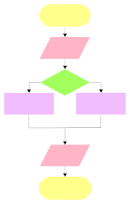
Activity Guide #4
Try one:
Create a flowchart of your program from Mission 5: Music1.
Your flowchart will not look like the example on the right.

Slide 20
Activity Guide #5
Try one:
With your partner, select a daily-life scenario and create a flowchart. The flowchart does not need to look like the example on the right.
Get ready for school
Select a song to listen to
Decide what to wear today
What should I eat for breakfast?
Do I eat lunch today?

Slide 21
Flowcharts Summary
Definition: An algorithm is a sequence of steps for completing a task.
Definition: A flowchart is a diagram that uses shapes, lines, and arrows to sequence steps.
Definition: A flowchart is a visual representation of the input, output, decisions, and actions that take place within a program.
Source: https://www.teachwithict.com/flowcharts.html#google_vignette

